Slide 1

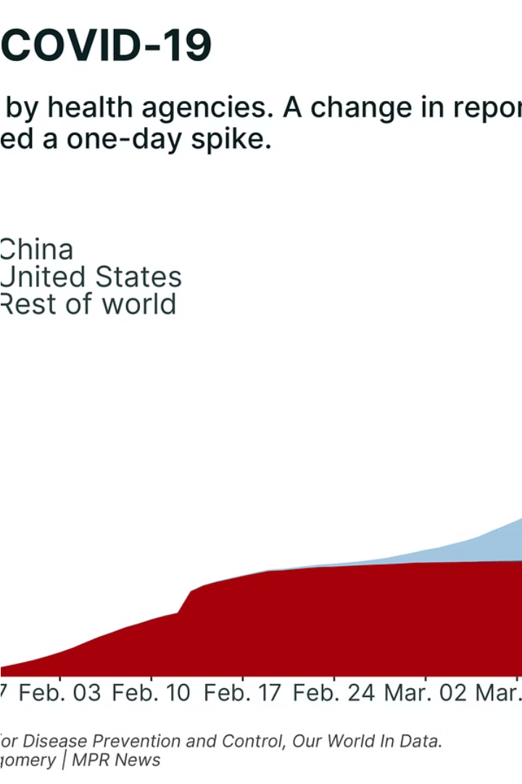


Introduction to COVID-19 Analysis using SQL
This presentation explores how SQL can be leveraged to gain valuable insights into the COVID-19 pandemic. By analyzing data from various sources, we can track case trends, identify regional hotspots, and uncover high-risk populations - all of which can inform effective management strategies.
by Alok Panwar

Slide 2
Data Sources and Preparation
Case Reporting Data
Demographic Data
Gather comprehensive data on confirmed COVID-19 cases, hospitalizations, and deaths from government and public health agencies.
Incorporate population statistics, age distributions, and socioeconomic indicators to identify high-risk groups.
Mobility Data
Intervention Data
Analyze foot traffic and transportation patterns to understand how human movement impacts the spread of the virus.
Monitor the implementation and effectiveness of measures such as lockdowns, mask mandates, and vaccination rollouts.

Slide 3
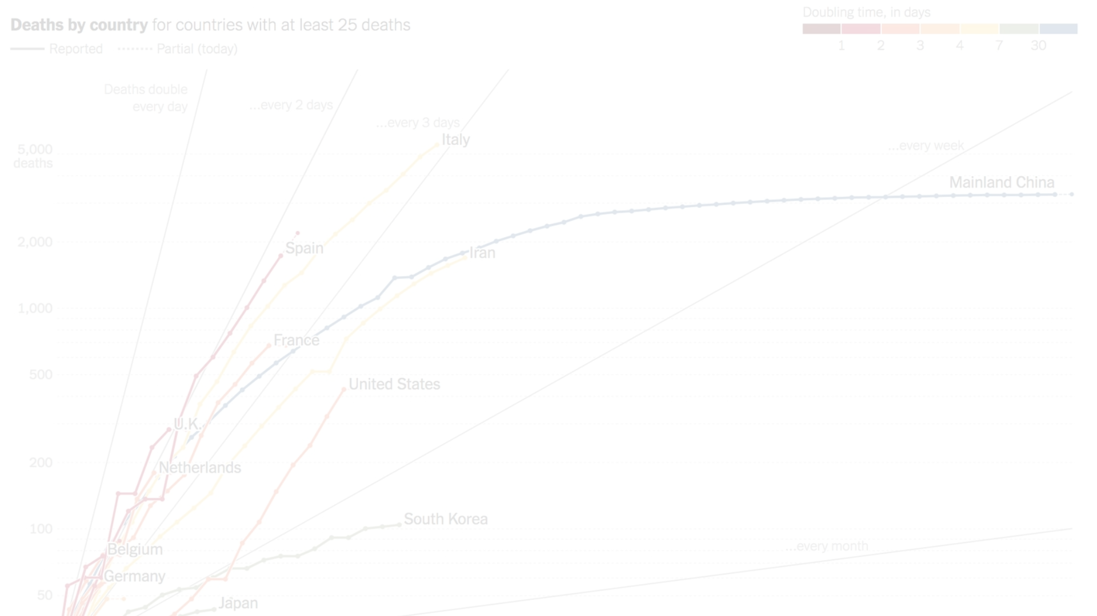
Tracking COVID-19 Cases over Time
Mortality Rates
Daily Case Counts
Analyze the number of COVID-19-related deaths to understand the severity of the outbreak and evaluate the effectiveness of interventions.
Monitor the daily number of new confirmed COVID-19 cases to identify trends and detect potential surges.
1
2
3
Hospitalization Rates
Track the number of COVID-19 hospitalizations to assess the strain on the healthcare system.

Slide 4
Analyzing Regional Trends and Hotspots
Geographic Spread
Demographic Factors
Mobility Patterns
Visualize the geographic distribution of COVID-19 cases to identify regional hotspots and understand how the virus is spreading across different areas.
Analyze case data by age, gender, and socioeconomic factors to understand which populations are being disproportionately affected.
Correlate case data with transportation and foot traffic patterns to identify areas where increased movement may be driving the spread of the virus.

Slide 5
Identifying High-Risk Populations
1
Elderly Individuals
2
Individuals with Comorbidities
Older adults, especially those with underlying health conditions, are at a higher risk of severe illness and mortality from COVID-19.
People with pre-existing medical conditions such as heart disease, diabetes, and lung disease are more vulnerable to the virus.
3
Marginalized Communities
4
Essential Workers
Socioeconomically disadvantaged populations often face barriers to healthcare access and may be disproportionately impacted by the pandemic.
Individuals employed in critical industries, such as healthcare, grocery stores, and transportation, have an elevated risk of exposure to the virus.

Slide 6
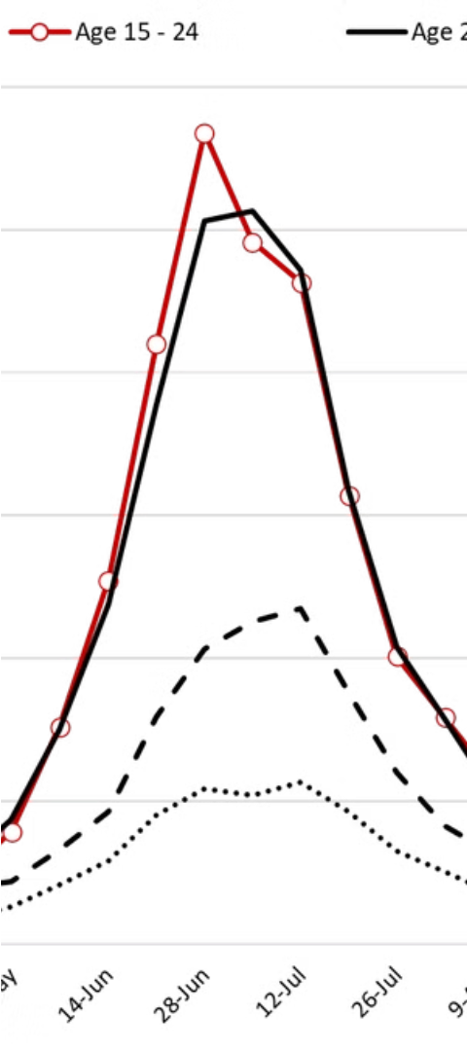



Forecasting Future Outbreaks
Trend Analysis
Examine historical case data to identify patterns and predict future case trajectories, helping organizations prepare for potential surges.
Predictive Modeling
Develop statistical models that incorporate factors such as vaccination rates, seasonality, and the impact of interventions to forecast future outbreaks.
Scenario Planning
Simulate different scenarios, such as the emergence of new variants or changes in human behavior, to anticipate a range of possible outcomes.

Slide 7
Evaluating the Effectiveness of Interventions
Lockdowns and Mobility Restrictions
Mask Mandates and Vaccination Rollouts
Economic and Social Impacts
Analyze the impact of stay-at-home orders, travel bans, and other mobility-reducing measures on case trends and transmission rates.
Assess the effectiveness of public health measures, such as mask requirements and vaccine distribution, in mitigating the spread of the virus.
Evaluate the broader consequences of COVID-19 interventions, including their effects on employment, education, and mental health.

Slide 8




Providing Actionable Insights for Management
Identify Trends
Detect Hotspots
Forecast Outbreaks
Assess Impact
Provide decision-makers with a clear understanding of evolving case patterns and the effectiveness of interventions.
Pinpoint high-risk regions and populations, enabling targeted resource allocation and mitigation strategies.
Evaluate the broader social, economic, and public health consequences of COVID-19 and the interventions implemented.
Equip organizations with predictive insights to anticipate future surges and proactively prepare their response.

